Slide 1

Digital Electronics (203105201)
Alpita makwana, Assistant Professor
Mechatronics Engineering

Slide 2
CHAPTER-3
Combinational Digital Circuits
Binary Adders and Subtractors, Parallel binary adder & Subtractor, serial adder, BCD adder, carry look-ahead adder, Multiplexer, De-Multiplexer/Decoders, popular MSI chips, Magnitude comparator, parity checker/generator, code converters, priority encoders, decoders/drivers for display devices.

Slide 3
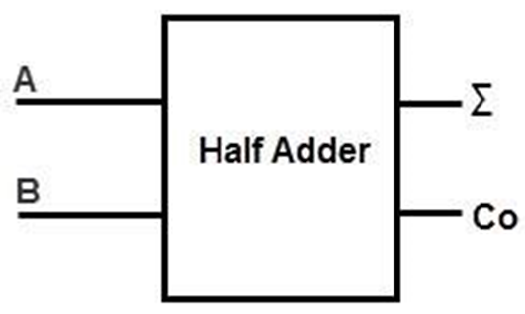
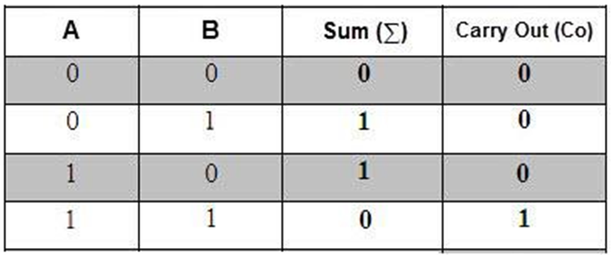
Combinational Digital Circuits
Binary Adder: The logic circuits designed to perform the addition of two binary numbers are called as Binary Adder Circuits
Half Adder
Full Adder
Half Adder: A logic circuit for adding two 1-bit numbers, or simply two bits. This circuit has two inputs and two outputs. The inputs are the two 1-bit binary numbers, and the outputs are Sum and Carry bits.

Slide 4
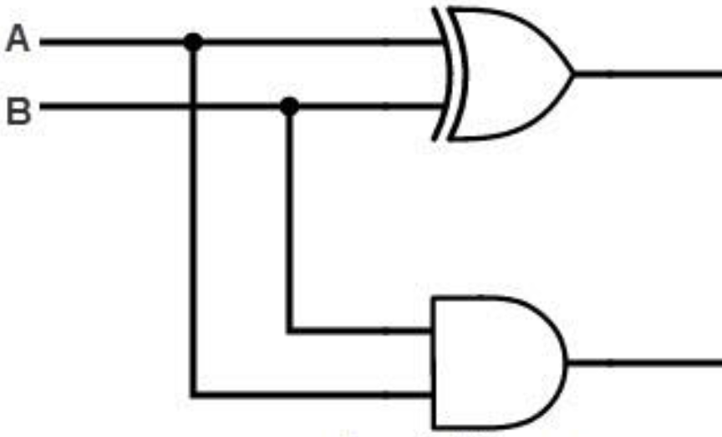
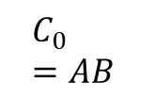
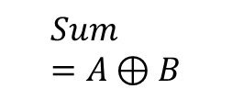
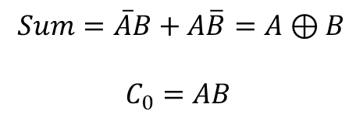
Combinational Digital Circuits
$$Sum=\overline{A}B+A\overline{B}=A⊕B$$
$$C_{0}=AB$$
A B | 0 | 1
0 | 0 | 1
1 | 1 | 0
7486
$$Sum=A⊕B$$
7408
A B | 0 | 1
0 | 0 | 0
1 | 0 | 1
$$C_{0}=AB$$

Slide 5
Combinational Digital Circuits
Full Adder (CD 4008 (CMOS)) : A logic circuit for adding two 1-bit numbers, or simply two bits, with previous input carry. This circuit has three inputs and two outputs. The inputs are the three 1-bit binary numbers, and the outputs are Sum and Carry-out bits.
Inputs |  |  | Outputs
A | B | C_{in} | Sum | C_{out}
0 | 0 | 0 | 0 | 0
0 | 0 | 1 | 1 | 0
0 | 1 | 0 | 1 | 0
0 | 1 | 1 | 0 | 1
1 | 0 | 0 | 1 | 0
1 | 0 | 1 | 0 | 1
1 | 1 | 0 | 0 | 1
1 | 1 | 1 | 1 | 1
$Sum= \overline{A}\overline{B}C_{in}+\overline{A}B\overline{C_{in}}+A\overline{B}$ $\overline{C_{in}}+{ABC}_{in}$
$$C_{out}= \overline{A}BC_{in}+A\overline{B}C_{in}+AB\overline{C_{in}}+{ABC}_{in}$$

Slide 6
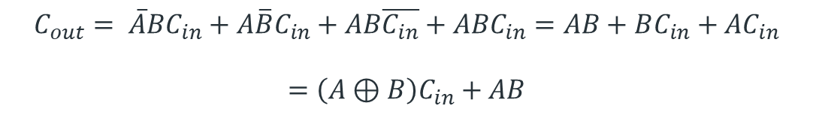
Combinational Digital Circuits
AB C_{in} | 00 | 01 | 11 | 10
0 | 0 | 1 | 0 | 1
1 | 1 | 0 | 1 | 0
AB C_{in} | 00 | 01 | 11 | 10
0 | 0 | 0 | 1 | 0
1 | 0 | 1 | 1 | 1
$Sum= \overline{A}\overline{B}C_{in}+\overline{A}B\overline{C_{in}}+A\overline{B}$ $\overline{C_{in}}+ABC_{in}$
$$C_{out}= \overline{A}BC_{in}+A\overline{B}C_{in}+AB\overline{C_{in}}+{ABC}_{in}=AB+BC_{in}+AC_{in}$$
$$=\left(A⊕B\right)C_{in}+AB$$

Slide 7
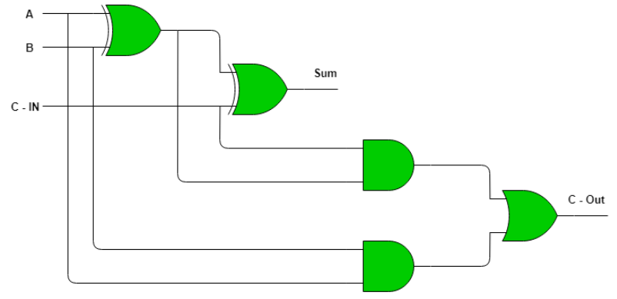
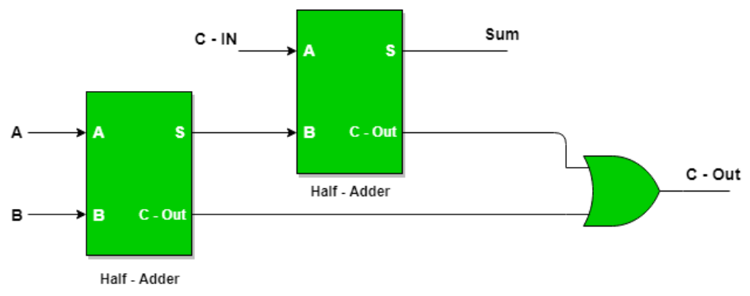

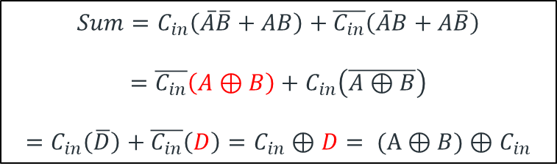
Combinational Digital Circuits
$$Sum=C_{in}\left(\overline{A}\overline{B}+AB\right)+\overline{C_{in}}\left(\overline{A}B+A\overline{B}\right)$$
$$=\overline{C_{in}}\left(A⊕B\right)+C_{in}\left(\overline{A⊕B}\right)$$
$$=C_{in}\left(\overline{D}\right)+\overline{C_{in}}\left(D\right)=C_{in}⊕D= (A⊕B)⊕C_{in}$$
$$C_{out}=\left(A⊕B\right)C_{in}+AB$$

Slide 8
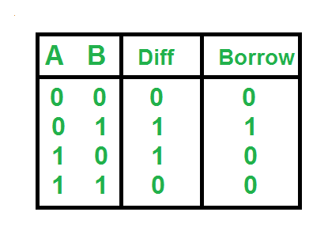
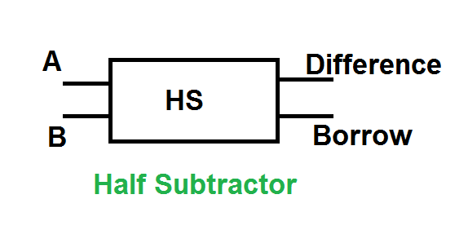
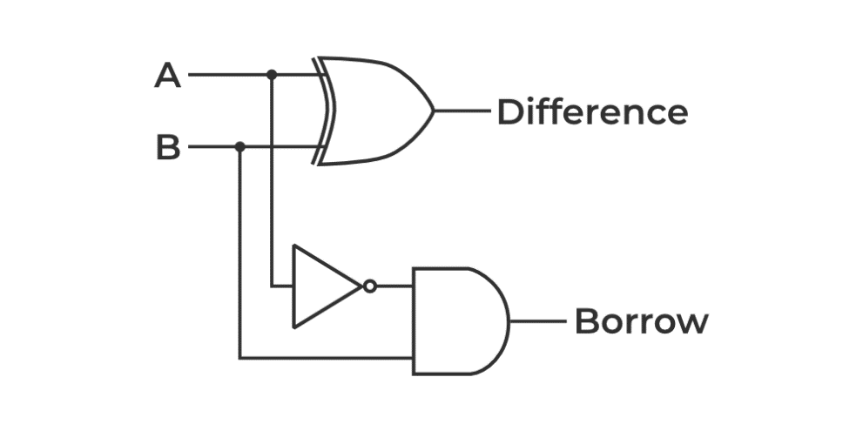
Combinational Digital Circuits
Half Subtractor: A logic circuit for subtracting two 1-bit numbers, or simply two bits. This circuit has two inputs and two outputs. The inputs are the two 1-bit binary numbers, and the outputs are Sum and Carry bits.
$$Difference =\overline{A}B+A\overline{B}=A⊕B$$
$$Borrow =\overline{A}B$$

Slide 9
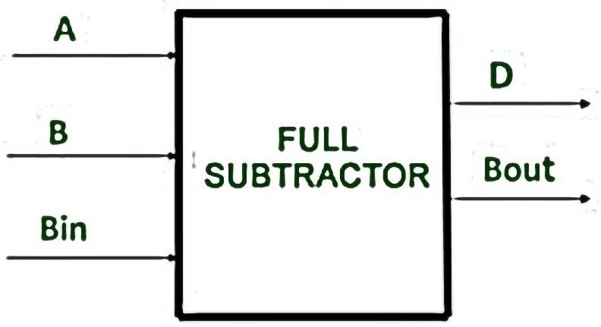
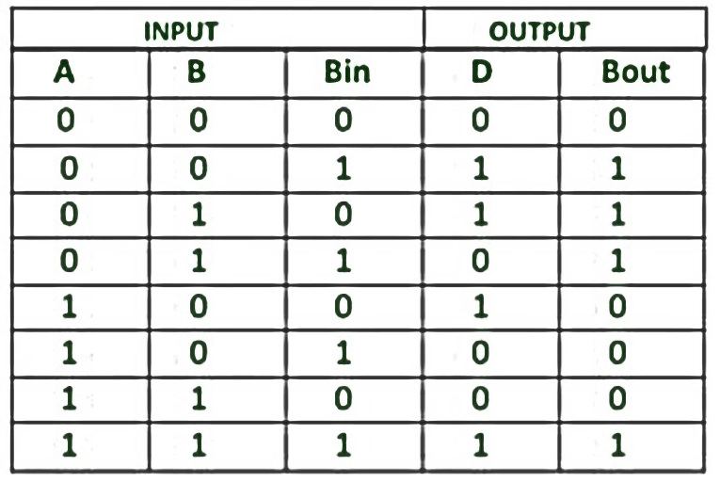
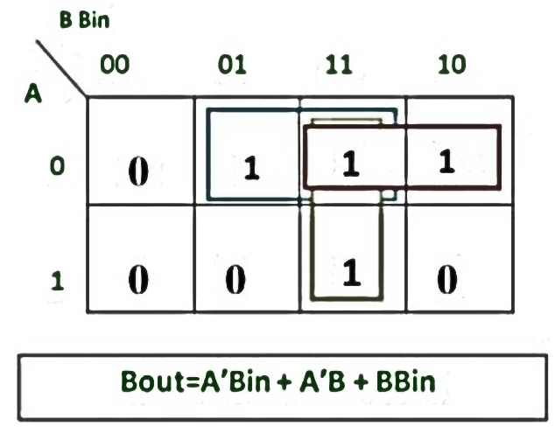
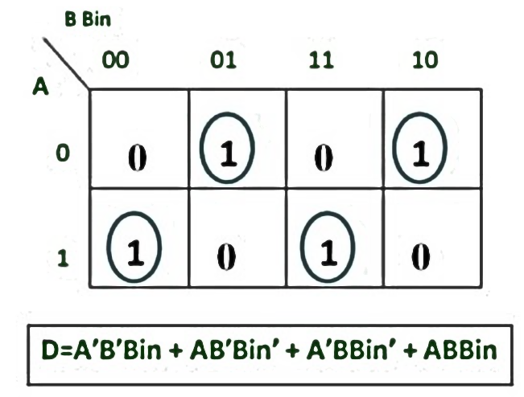
Combinational Digital Circuits
Full Subtractor: A logic circuit for subtracting two 1-bit numbers, or simply two bits, taking into account the previous borrow bit. This circuit has three inputs and two outputs. The inputs are the two 1-bit binary numbers, and the previous borrow it, and the outputs are Difference and output-borrow bits.
$$D=\overline{A}\overline{B}B_{in}+A\overline{B}\overline{B_{in}}+\overline{A}B\overline{B_{in}}+ABB_{in}$$
$$B_{out} =\overline{A}B_{in}+\overline{A}B+BB_{in}$$

Slide 10
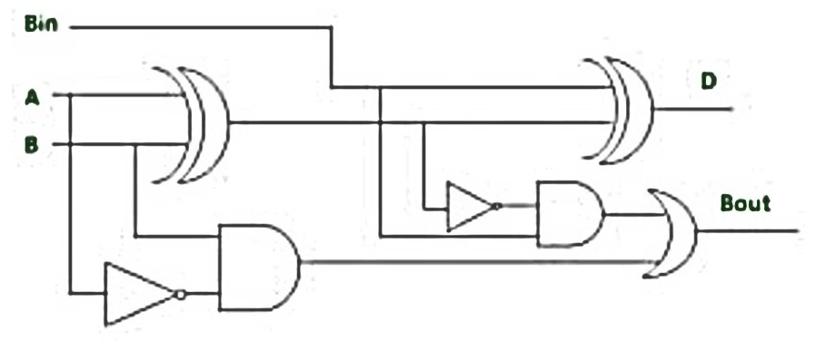
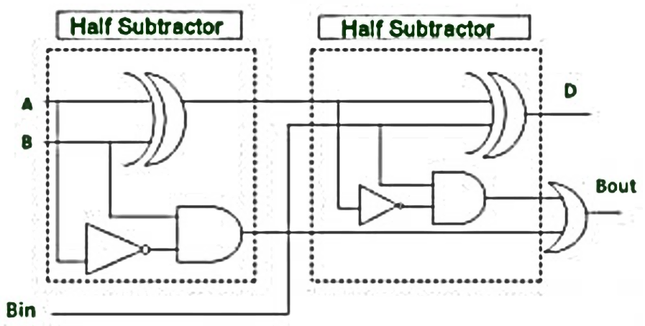
Combinational Digital Circuits

Slide 11
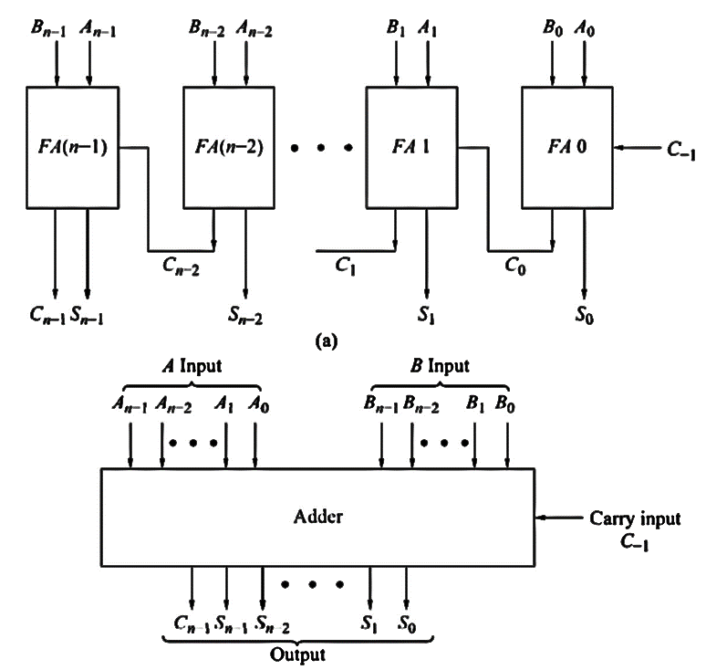
Combinational Digital Circuits
Parallel Binary Adder (74LS83):
A single full adder adds two one-bit numbers and an input carry.
A Parallel Adder is a digital circuit capable of finding the arithmetic sum of two binary numbers that are greater than one bit in length by operating on corresponding pairs of bits in parallel.
It consists of full adders connected in a chain where the output carry from each full adder is connected to the carry input of the next higher order full adder in the chain.
An n-bit parallel adder requires n full adders to perform the operation. So for the two-bit number, two adders are needed while for four-bit numbers, four adders are needed, and so on.

Slide 12
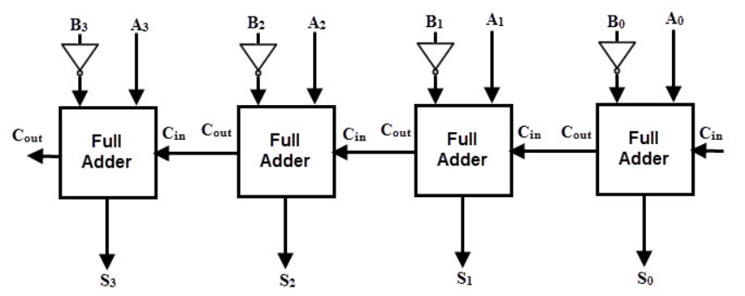
Combinational Digital Circuits
Parallel Binary Subtractor:
A Parallel Subtractor is a digital circuit capable of finding the arithmetic difference between two binary numbers that are greater than one bit in length by operating on corresponding pairs of bits in parallel.
The parallel subtractor can be designed in several ways: including a combination of half and full subtractors, all full subtractors, or all full adders with subtrahend complement input.

Slide 13
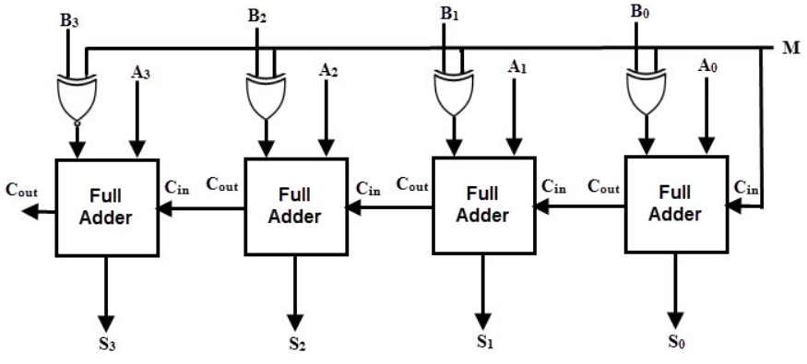
Combinational Digital Circuits
Parallel Binary Adder/ Subtractor:
The operations of both addition and subtraction can be performed by a one common binary adder. Such a binary circuit can be designed by adding an Ex-OR gate with each full adder as shown in figure. The figure shows the 4-bit parallel binary adder/subtractor which has two 4-bit inputs as ‘A₃ A₂ A₁ A₀‘ and ‘B₃ B₂ B₁ B₀‘.
The mode input control line M is connected with the carry input of the least significant bit of the full adder. This control line decides the type of operation, whether addition or subtraction.
When M= 1, the circuit is a subtractor and when M=0, the circuit becomes adder. The Ex-OR gate consists of two inputs to which one is connected to the B and the other to input M. When M = 0, B Ex-OR of 0 produces B. Then, full adders add the B with A with carry input zero and hence an addition operation is performed.
When M = 1, B Ex-OR of 0 produces B complement and also carry input is 1. Hence the complemented B inputs are added to A and 1 is added through the input carry, nothing but a 2’s complement operation.

Slide 14
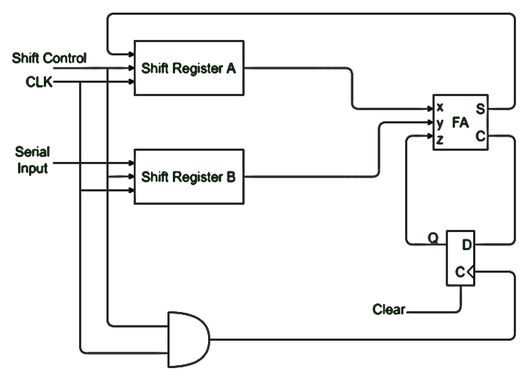
Combinational Digital Circuits
Serial Adder:
Serial binary adder is a combinational logic circuit that performs the addition of two binary numbers in serial form. Serial binary adder performs bit-by-bit addition.
Two shift registers are used to store the binary numbers that are to be added.
A single full adder is used to add one pair of bits at a time along with the carry.
The carry output from the full adder is applied to a D flip-flop.
After that output is used as a carry for the next significant bits.
The sum bit from the output of the full adder can be transferred into a third shift register.

Slide 15
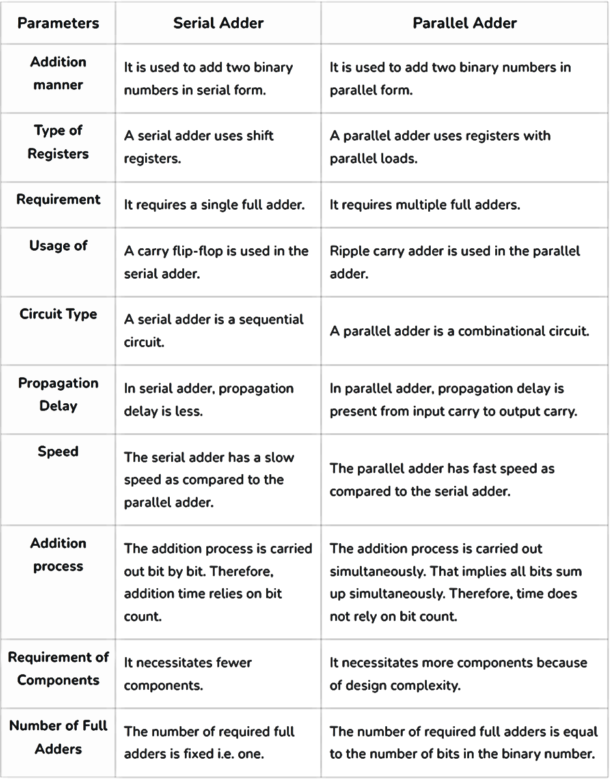
Combinational Digital Circuits

Slide 16
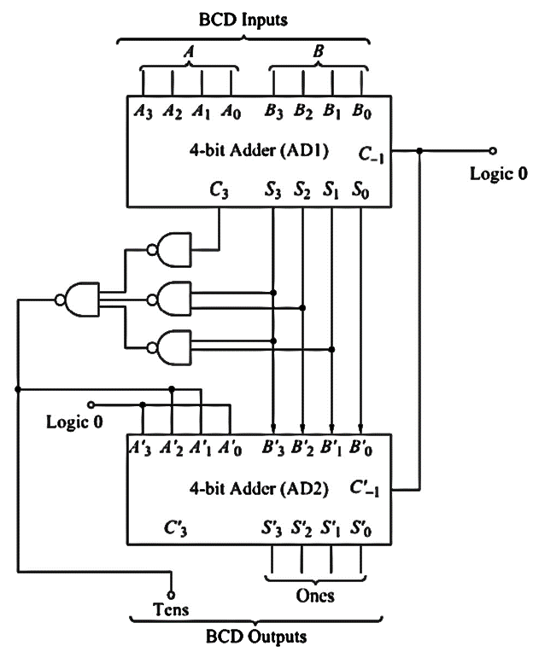
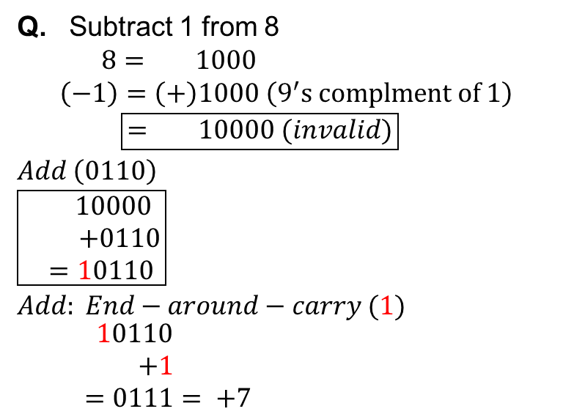
Combinational Digital Circuits
BCD adder: the 4-bit binary adder IC (7483) can be used to perform BCD addition.
If the output is not valid BCD code, or, if carry bit C3 is generated, then 6 (0110) is to be added to the sum, to get the correct output.
Q. Subtract 1 from 8
$8= 1000$
$$\left(−1\right)=\left(+\right)1000 \left(9^{′}s complment of 1\right)$$
$$\boxed{= 10000 (invalid)}$$
$$Add \left(0110\right)$$
$$\boxed{\begin{aligned} 10000 \\ +0110 \\ =10110\end{aligned}}$$
$$Add: End−around−carry (1)$$
$$\begin{aligned}10110 \\ +1 \\ =0111= +7\end{aligned}$$

Slide 17
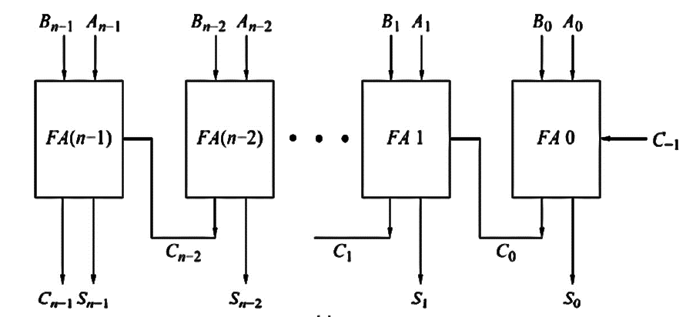
Combinational Digital Circuits
Carry Look-ahead adder (74182): Carry has to propagate along C₋₁ to C₀ to C_{n-1} (LSB to MSB position). This decreases the speed of addition.
Hence, a technique called look-ahead carry is used for addition.
C₀ and S₀ (from FA 0) are generated after some propagation delay. Only C₀ is required to propagate upto FA(n-1).
The proper output of FA1 (after its own delay) is generated only after the propagation delay of FA0, after receiving C_{0.}
Therefore, total delay in FA1 output = delay due to FA0 + delay due to FA1.
Hence, the propagation delay depends on the number of FA stages.

Slide 18
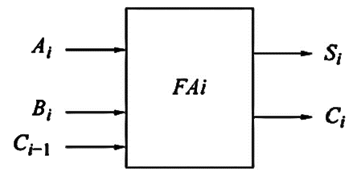
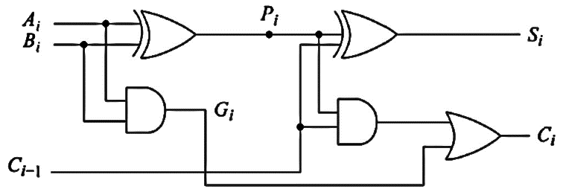
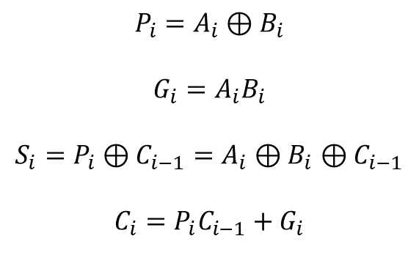
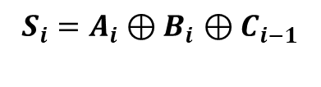
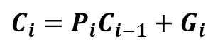
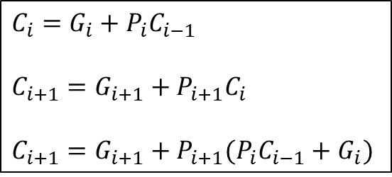
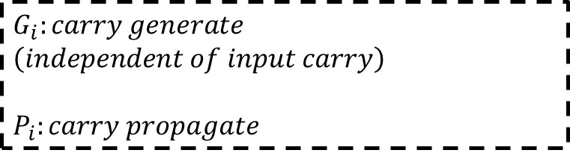
Combinational Digital Circuits
$$P_{i}=A_{i}⊕B_{i}$$
$$G_{i}=A_{i}B_{i}$$
$S_{i}=P_{i}⊕C_{i−1}=A_{i}⊕B_{i}$ $⊕C_{i−1}$
$C_{i}=$ $P_{i}C_{i−1}+G_{i}$
$S_{i}=A_{i}⊕B_{i}$ $⊕C_{i−1}$
$C_{i}=$ $P_{i}C_{i−1}+G_{i}$
$C_{i}=$ ${G_{i}+P}_{i}C_{i−1}$
$C_{i+1}=$ ${G_{i+1}+P}_{i+1}C_{i}$
$C_{i+1}=$ ${G_{i+1}+P}_{i+1}(P_{i}C_{i−1}+G_{i})$
$$G_{i}:carry generate$$
$$\left(independent of input carry\right)$$
$$P_{i}:carry propagate$$

Slide 19
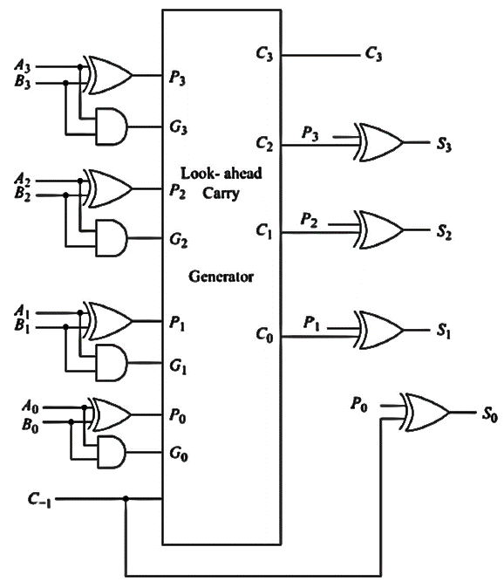
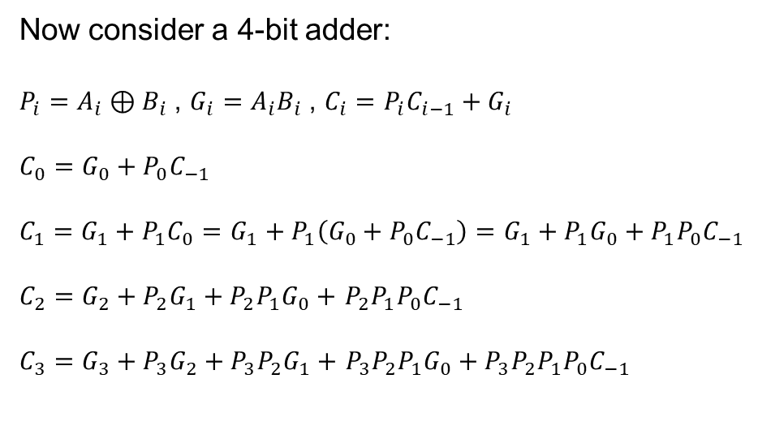
Combinational Digital Circuits
Now consider a 4-bit adder:
$P_{i}=A_{i}⊕B_{i}$ , $G_{i}=A_{i}B_{i}$ , $C_{i}=$ $P_{i}C_{i−1}+G_{i}$
$C_{0}=$ ${G_{0}+P}_{0}C_{−1}$
$C_{1}=$ ${G_{1}+P}_{1}C_{0}=$ ${G_{1}+P}_{1}\left({G_{0}+P}_{0}C_{−1}\right)={G_{1}+P}_{1}G_{0}+P_{1}P_{0}C_{−1}$
$C_{2}=$ ${G_{2}+P}_{2}G_{1}+P_{2}P_{1}G_{0}+$ $P_{2}P_{1}{P_{0}C}_{−1}$
$C_{3}=$ ${G_{3}+P}_{3}G_{2}+{P_{3}P}_{2}G_{1}+$ ${P_{3}P}_{2}P_{1}G_{0}+{P_{3}P}_{2}P_{1}P_{0}C_{−1}$
Fig. a 4-bit adder with look-ahead carry

Slide 20
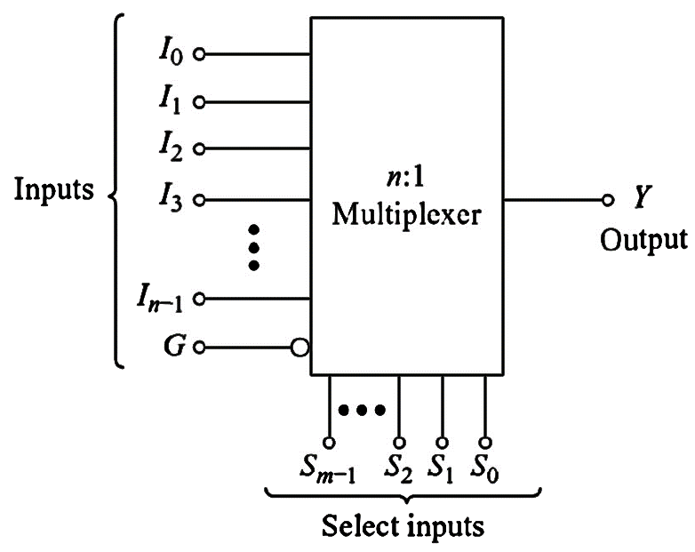
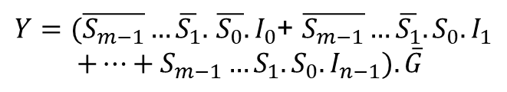
Combinational Digital Circuits
Multiplexer: A special combinational circuit that gates one out of several inputs to a single output.
Most widely used standard logic circuits.
The input selected is controlled by the select lines
For multiplexers with n-input lines, m-select lines are required for controlling (n=2^{m})
Depending upon the code at the select inputs, one out of n-inputs is selected and transferred to the output channel.
For operating a multiplexer, an enable (strobe) input line (G) is utilized in the active-low state. At a high state, the multiplexer outputs zero.
$Y=(\overline{S_{m−1}}…\overline{S_{1}}.$ $\overline{S_{0}}.I_{0}$+ $\overline{S_{m−1}}…\overline{S_{1}}.S_{0}.I_{1}$
$+…+S_{m−1}…S_{1}.S_{0}. I_{n−1}). \overline{G}$

Slide 21
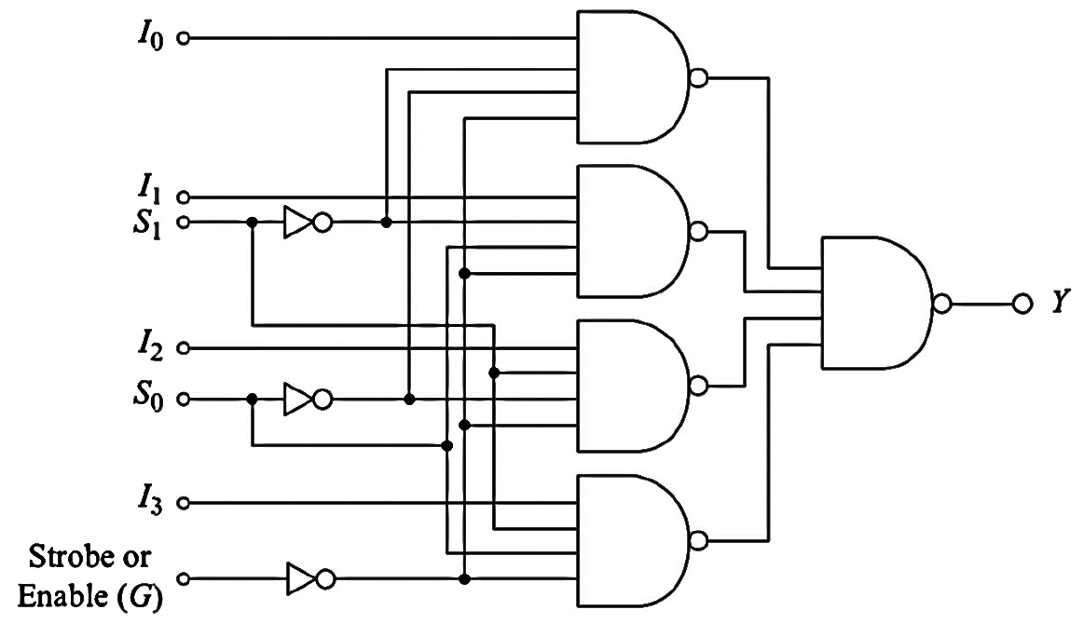
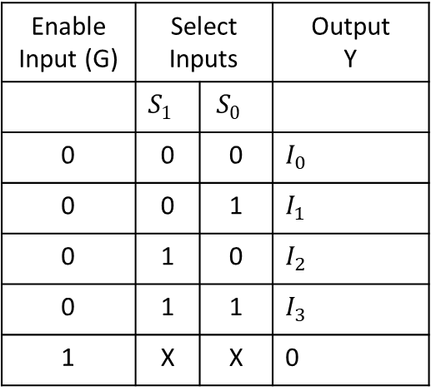
Combinational Digital Circuits
The truth table of a 4:1 multiplexer is shown below
Enable Input (G) | Select Inputs |  | Output Y
 | $$S_{1}$$ | $$S_{0}$$
0 | 0 | 0 | $$I_{0}$$
0 | 0 | 1 | $$I_{1}$$
0 | 1 | 0 | $$I_{2}$$
0 | 1 | 1 | $$I_{3}$$
1 | X | X | 0
$Y=(\overline{S_{1}}.\overline{S_{0}}.I_{0}$+ $\overline{S_{1}}.S_{0}.I_{1}+S_{1}.\overline{S_{0}}.I_{2}+S_{1}.S_{0}.I_{3}). \overline{G}$

Slide 22
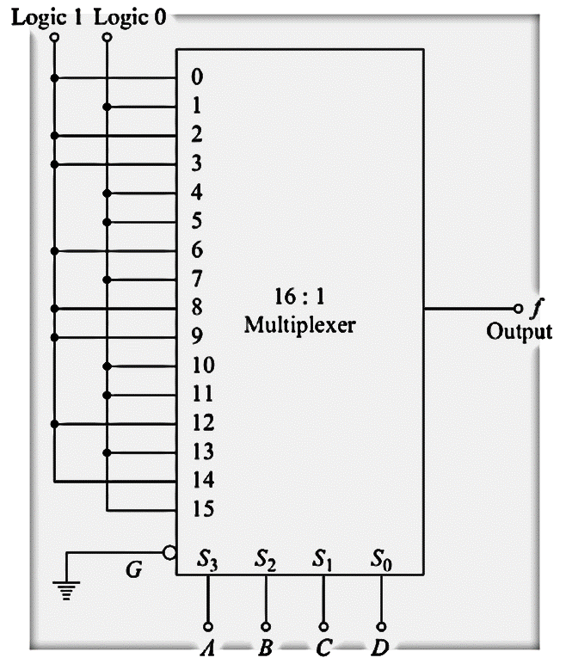
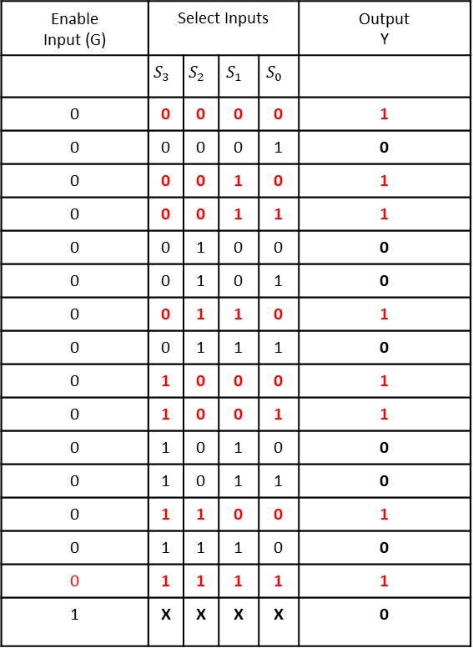
Combinational Digital Circuits
Q. f(A,B,C,D)= ∑m (0,2,3,6,8,9,12,14)
Enable Input (G) | Select Inputs |  |  |  | Output Y
 | $$S_{3}$$ | $$S_{2}$$ | $$S_{1}$$ | $$S_{0}$$
0 | 0 | 0 | 0 | 0 | 1
0 | 0 | 0 | 0 | 1 | 0
0 | 0 | 0 | 1 | 0 | 1
0 | 0 | 0 | 1 | 1 | 1
0 | 0 | 1 | 0 | 0 | 0
0 | 0 | 1 | 0 | 1 | 0
0 | 0 | 1 | 1 | 0 | 1
0 | 0 | 1 | 1 | 1 | 0
0 | 1 | 0 | 0 | 0 | 1
0 | 1 | 0 | 0 | 1 | 1
0 | 1 | 0 | 1 | 0 | 0
0 | 1 | 0 | 1 | 1 | 0
0 | 1 | 1 | 0 | 0 | 1
0 | 1 | 1 | 1 | 0 | 0
0 | 1 | 1 | 1 | 1 | 1
1 | X | X | X | X | 0

Slide 23
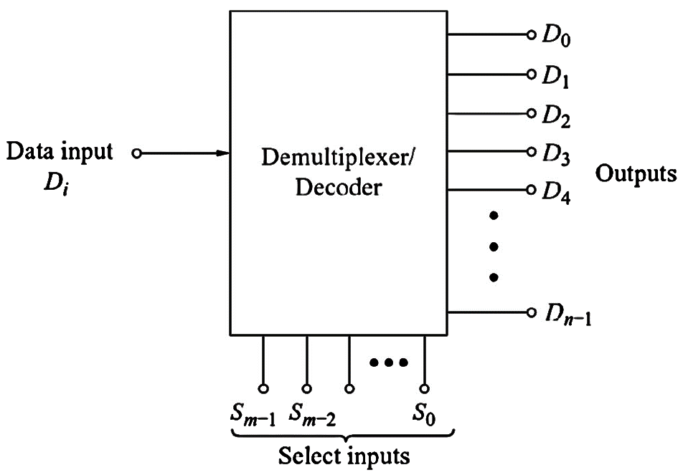
Combinational Digital Circuits
Demultiplexer: It performs the reverse of a multiplexer.
It accepts a single input and distributes it over several outputs.
The select input code determines to which output the data input will be transmitted.
For demultiplexers with n-output lines, m-select lines are required for controlling (n=2^{m})
The data input D_{i} will appear on the output line selected by the select input.
This can also be used as a binary to decimal decoder.

Slide 24
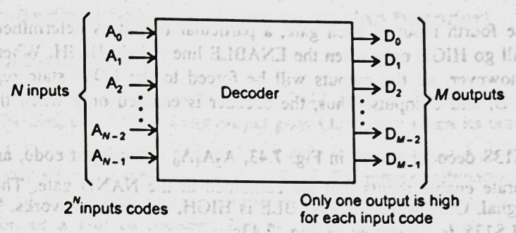
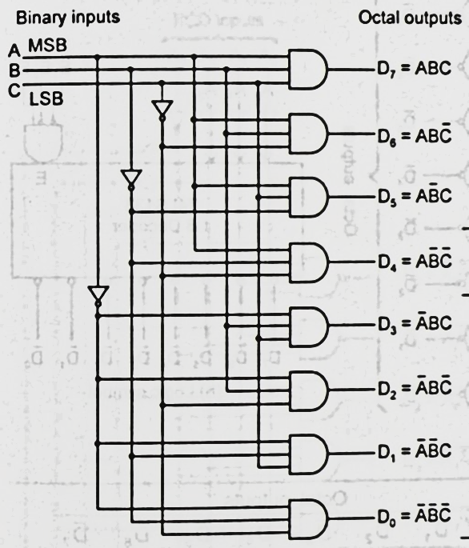
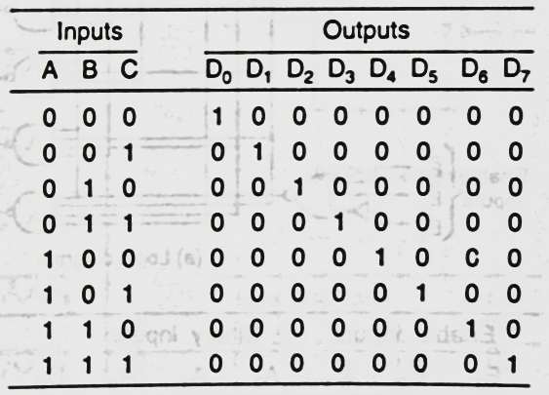
Combinational Digital Circuits

Slide 25
Combinational Digital Circuits
PARAMETERS | DEMULTIPLEXER | DECODER
Definition | A demultiplexer is a circuit which takes only one input and switches it to one of the several outputs with the help of selection lines. | A decoder is the circuit which decodes the input signal fed to it with the help of control signal.
Data Input | A demultiplexer accepts the data as input. | A decoder accepts control signals as input.
Number of Inputs | Only one | One or more signals can be given as input.
Number of Outputs | The output depends on the number of selection lines. The number of outputs will be equivalent to 2 raised to the power of selection lines. If there are n selection lines then output will be 2^n. | The outputs depends on the number of control signals. If there are n control signals then the output will be 2^n.
Need of selection lines | Required | Not required, but control signals and enable signal is required.
Main Function | Used for switching | Used for decoding of the encoded input terminal.

Slide 26
Combinational Digital Circuits
Popular MSI (Medium scale integration: 500 components (from 10 to less than 100 gates))
IC No. | Description | Output
74157 | Quad 2:1 Multiplexer | Same as input
74158 | Quad 2:1 Multiplexer | Inverted input
74153 | Dual 4:1 Multiplexer | Same as input
74352 | Dual 4:1 Multiplexer | Inverted input
74151 | 8:1 Multiplexer | Complementary outputs
74152 | 8:1 Multiplexer | Inverted input
74150 | 16:1 Multiplexer | Inverted input
74139 | Dual 1:4 Demultiplexer (2-line to 4-line decoder) | Inverted input
74155 | Dual 1:4 Demultiplexer (2-line to 4-line decoder) | 1 Y-inverted input 2 Y- same as input
74138 | 1:8 Demultiplexer (3-line to 8-line decoder) | Inverted input
74154 | 1:16 Demultiplexer (4-line to 16-line decoder) | Same as input

Slide 27
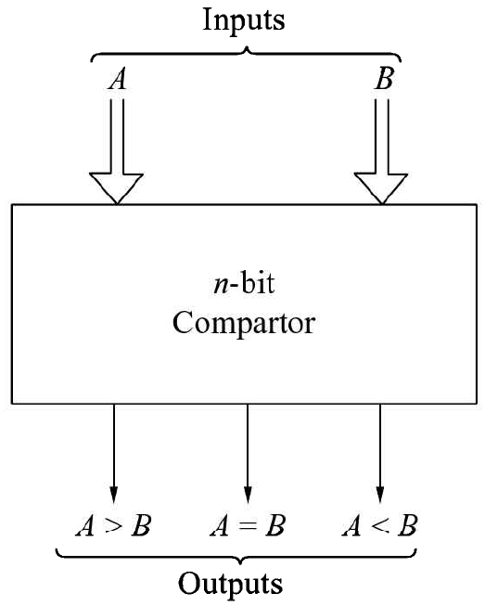
Combinational Digital Circuits
Magnitude comparator (7485 (4-bit)): a magnitude comparator compares two numbers and provides outputs depending on the values of the compared numbers.
The figure shows an n-bit comparator that produces the output as either A>B, A=B, or, A<B.
The 4-bit comparators are available as MSI IC package (7485) which can compare binary and BCD codes.
The truth table of a 2-bit comparator is given next

Slide 28
Combinational Digital Circuits
Inputs |  |  |  | Outputs
A₁ | A₀ | B₁ | B₀ | A>B | A=B | A<B
0 | 0 | 0 | 0 | 0 | 1 | 0
0 | 0 | 0 | 1 | 0 | 0 | 1
0 | 0 | 1 | 0 | 0 | 0 | 1
0 | 0 | 1 | 1 | 0 | 0 | 1
0 | 1 | 0 | 0 | 1 | 0 | 0
0 | 1 | 0 | 1 | 0 | 1 | 0
0 | 1 | 1 | 0 | 0 | 0 | 1
0 | 1 | 1 | 1 | 0 | 0 | 1
1 | 0 | 0 | 0 | 1 | 0 | 0
1 | 0 | 0 | 1 | 1 | 0 | 0
1 | 0 | 1 | 0 | 0 | 1 | 0
1 | 0 | 1 | 1 | 0 | 0 | 1
1 | 1 | 0 | 0 | 1 | 0 | 0
1 | 1 | 0 | 1 | 1 | 0 | 0
1 | 1 | 1 | 0 | 1 | 0 | 0
1 | 1 | 1 | 1 | 0 | 1 | 0

Slide 29
Combinational Digital Circuits
Parity Generator (74280 (9-bit)): a combinational logic circuit that generates the parity bit in the transmitter. The other circuit that checks the parity in the receiver is called Parity Checker.
A | B | C | D | f (Even-parity)
0 | 0 | 0 | 0 | 0
0 | 0 | 0 | 1 | 1
0 | 0 | 1 | 0 | 1
0 | 0 | 1 | 1 | 0
0 | 1 | 0 | 0 | 1
0 | 1 | 0 | 1 | 0
0 | 1 | 1 | 0 | 0
0 | 1 | 1 | 1 | 1
1 | 0 | 0 | 0 | 1
1 | 0 | 0 | 1 | 0
1 | 0 | 1 | 0 | 0
1 | 0 | 1 | 1 | 1
1 | 1 | 0 | 0 | 0
1 | 1 | 0 | 1 | 1
1 | 1 | 1 | 1 | 0
CD AB | 00 | 01 | 11 | 10
00 | 0 |  | 0
01 |  | 0 |  | 0
11 | 0 |  | 0
10 |  | 0 |  | 0
K-map for f’ (POS)

Slide 30
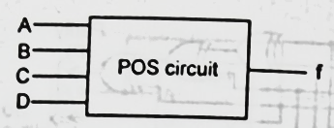
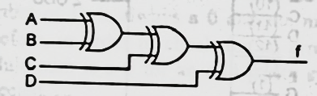
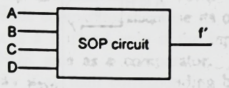


Combinational Digital Circuits
$$f\left(A,B,C,D\right)=\left(A+B+C+D\right)\left(A+B+\overline{C}+\overline{D}\right)\left(A+\overline{B}+C+\overline{D}\right)\left(A+\overline{B}+\overline{C}+D\right)\left(\overline{A}+B+C+\overline{D}\right)\left(\overline{A}+B+\overline{C}+D\right)\left(\overline{A}+\overline{B}+C+D\right)\left(\overline{A}+B+C+\overline{D}\right)\left(\overline{A}+B+\overline{C}+D\right)$$
$$=A⨁B⨁C⨁D$$
In SOP form:

Slide 31

Combinational Digital Circuits
Parity Checker: a combinational logic circuit for checking the parity bit of the received codeword.

Slide 32




Combinational Digital Circuits
Code converter: a combinational logic circuit for converting input codeword into output codeword, eg. Binary-to-gray, gray-to-binary, binary-to-BCD, BCD-to-binary, BCD-to-excess3, excess3-to-BCD, etc.
$$G_{4}=B_{4}$$
$$G_{3 }=\overline{B_{4}}B_{3}+B_{4}\overline{B_{3}}=B_{4}⊕B_{3}$$
$$G_{2 }=\overline{B_{3}}B_{2}+B_{3}\overline{B_{2}}=B_{3}⊕B_{2}$$
$$G_{1 }=\overline{B_{2}}B_{1}+B_{2}\overline{B_{1}}=B_{2}⊕B_{1}$$

Slide 33


Combinational Digital Circuits
Priority encoder (74148 8-to-3 line priority encoder):
The priority encoder is a circuit that executes the priority function.
The logic of the priority encoder is such that when two or more inputs appear simultaneously, the input having the largest priority will take precedence.
Inputs |  |  |  | Outputs |  |  | Boolean Function
$$I_{0}$$ | $$I_{1}$$ | $$I_{2}$$ | $$I_{3}$$ | $$X$$ | $$Y$$ | $$IST$$ (Interrupt Status)
1 | X | X | X | 0 | 0 | 1
0 | 1 | X | X | 0 | 1 | 1 | $$X=\overline{I_{0}}\overline{I_{1}}$$
0 | 0 | 1 | X | 1 | 0 | 1 | $$X=\overline{I_{0}}\overline{I_{1}}+\overline{I_{0}}\overline{I_{2}}$$
0 | 0 | 0 | 1 | 1 | 1 | 1 | $$\left(IST\right)=I_{0}+I_{1}+I_{2}+I_{3}$$
0 | 0 | 0 | 0 | X | X | 0
The truth table of a four-input priority encoder is given in the table. The X’s in the table designate don’t care conditions. Input $I_{0}$ has the largest priority, so indifferent of the values of other inputs when this is input is 1, the output creates an output $XY=00$.

Slide 34

Combinational Digital Circuits
I₁ has the next priority level. The output is 01 if I₁=1 supported that I₀=0, regardless of the values of the other two lower-priority inputs.
The output for I₂ is generated only if higher-priority inputs are 0, etc. down the priority level.
The interrupt status IST is set only when one or more inputs are equal to 1.
If all inputs are 0, IST is cleared to 0 and the other outputs of the encoder are not used, so they are signified with don’t care condition.
This is because the vector address is not shared with the CPU when IST=0.
The Boolean function showed in the table determines the internal logic of the encoder.
Generally, a computer will have more than four interrupt sources. A priority encoder with eight inputs, for example, will create an output of three bits.
The output of the priority encoder can form part of the vector address for each interrupt source. The other bits of the vector address can be created any value. For instance, the vector address can be formed by joining six zeroes to the $X$
and $Y$ outputs of the encoder.
With this choice, the interrupt vector for the four I/O devices is created with numbers 0, 1, 2, and 3.

Slide 35


Combinational Digital Circuits
Decoders/drivers for display devices
Used in display devices to view the output, e.g. indicator/relay driver, nixie tube driver, LED output, seven-segment display, etc.

Slide 36

Combinational Digital Circuits

Slide 37


Combinational Digital Circuits

